Slide 1
Chemical Engineering
Nan Khaing
Yuxiang Xu
Matthew Ernst

Slide 2
Salary/earnings
The average pay for a chemical engineer is roughly $73K per year
Pay ranges for chemical engineers range between $51K and $119K
This can include up to $15K in bonuses and $10K in profit sharing

Slide 3
Early contributors/inventors
George Edward Davis (1850-1907)
Father of Discipline of Chemical Engineering
Lectures in the University of Manchester of Science and Technology
Wrote “A Handbook of Chemical Engineering”
Robert Samuel Langer, Jr. (1948-present)
Father of Tissue Engineering; engineered blood vessels and muscle tissue
Known for contributions to medicine and biotechnology
Margaret Hutchinson Rousseau (1910-2000)
First woman to receive doctorate in Chemical Engineering
Known for producing the first penicillin plant
Also known for processes involving high octane gasoline

Slide 4
Expected Need
Chemical engineers design and develop chemical manufacturing processes.
They apply principles of chemistry, physics, and mathematics to solve problems involving food, drugs, chemicals, etc.
Chemical engineers are expected to design, plan, troubleshoot, and research plans and procedures regarding chemical manufacturing devices or processes.

Slide 5
Major Inventions
Two major inventions brought as a result of chemical engineering:
Antibiotics-any molecule made by a microbe that antagonizes the growth of other microbes. Development began in 1945-1955 with penicillin, streptomycin, and tetracycline.
Plastics-all plastics are made from the same type of material: polymers; molecules made of carbon. In the 1840s, the Americans and the British made vulcanized rubber by treating it with sulfur to make it more durable.

Slide 6
Educational requirements
Must have bachelor’s in chemical engineering
(takes 4 years of study in classroom, laboratory, and field)
Science courses such as biology, chemistry, and physics are critical in becoming a chemical engineer
Math courses like algebra, trigonometry, and calculus are also essential

Slide 7
Cost of education Indiana Colleges Offering Four Year Bachelor’s Degrees in Chemical Engineering
College | Out Of State Total Cost | In State Total Cost
Purdue University Main Campus | $40,054 | $21,252
Trine University | $42,910 | $42,910
Rose Human Institute of Technology | $61,003 | $61,003
University of Notre Dame | $65,093 | $65,093
http://www.collegecalc.org/majors/chemical-engineering/

Slide 8
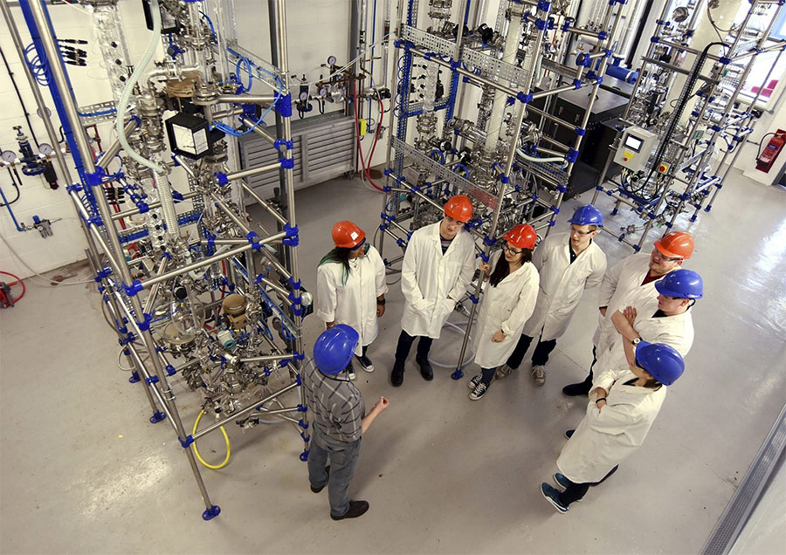
A Day In The Life
offices
Laboratories
industrial settings to oversee production.
Their main tasks involve overseeing direct operations or solving onsite problems.
They must work with technicians and mechanics in designing systems and putting them into practice.
https://cdn.careeronestop.org/OccVids/OccupationVideos/17-2041.00.mp4

Slide 9
Future things to design
There are many possible future career choices for chemical engineers. Here are a few:
Space fuel: chemical engineers are working to find new sources for fuels, such as hydrogen cells, fusion technology, bio-refineries, etc.
Genetic pharmacy: farmers of the future will grow genetically engineered plants to produce proteins and pharmaceuticals, relying heavily on chemical engineers to work on the processes involved
Vertical agriculture: the use of vertical farms to increase food production will rely on chemical engineers to increase our food yields and reduce environmental damage.

Slide 10
Sources
https://ichemeblog.org/2014/09/04/ten-future-careers-of-chemical-engineers-day-100/
https://www.processingmagazine.com/chemical-engineers-select-top-10-inventions-of-modern-era/
http://www.payscale.com/research/US/Job=Chemical_Engineer/Salary

